Slide 1

Cross Selling
By Jason Sanchez Team Alpha
16-Oct-2023

Slide 2
Background – Cross selling recommendation
XYZ credit union in Latin America is performing very well in selling the Banking products (eg: Credit card, deposit account, retirement account, safe deposit box etc) but their existing customer is not not buying more than 1 product which means bank is not performing good in cross selling (Bank is not able to sell their other offerings to existing customer). XYZ Credit Union decided to approach ABC analytics to solve their problem.
Objective: Should the company Upsell or Cross-Sell
The analysis has been divided into five parts:
Business Understanding
Data understanding
Data Cleansing and Transformation
Do EDA
EDA result and presentation

Slide 3
Data Exploration
48 Features( including 9 derived features)
Timeframe of the data: 1995-01-16 to 2016-08-28
Total data points:
Assumptions:
Most of the data are NaN values which means to analyze we must cleanse it.
We can calculate the average rent for each customer from called renta and figure out the group of people who are participating and those that aren’t.
Users from different provinces will be listed and the common use of products offered in banks.
Test.csv
Train.csv
Cross-Selling FInal Data

Slide 4
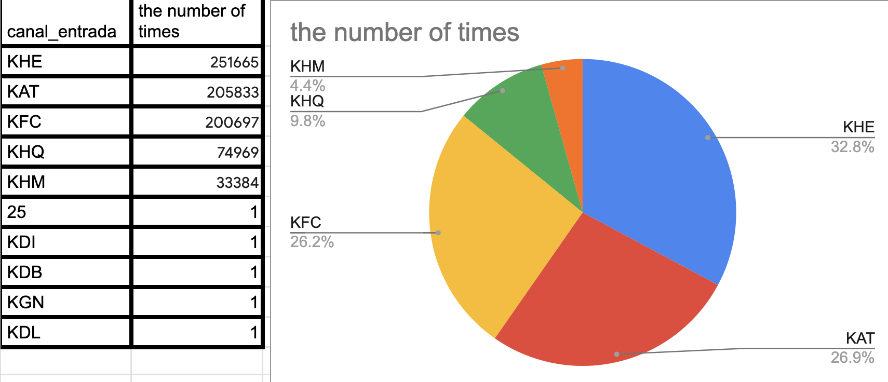
Profit Analysis
Profit Analysis
This list the channel entries and how many times it was checked
Channel KAT is the most common

Slide 5
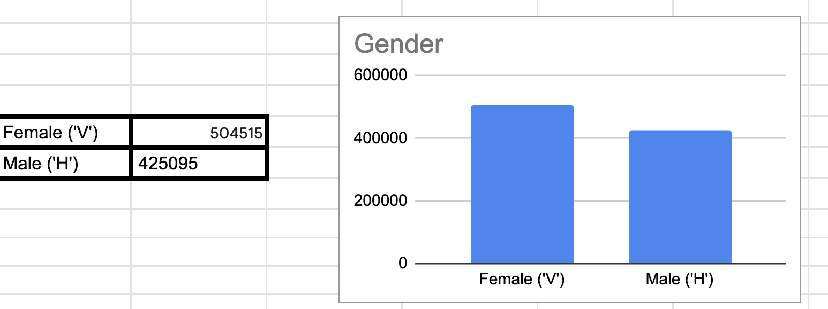
Profit and customer base Analysis Gender wise
There are more Female the male customers.

Slide 6
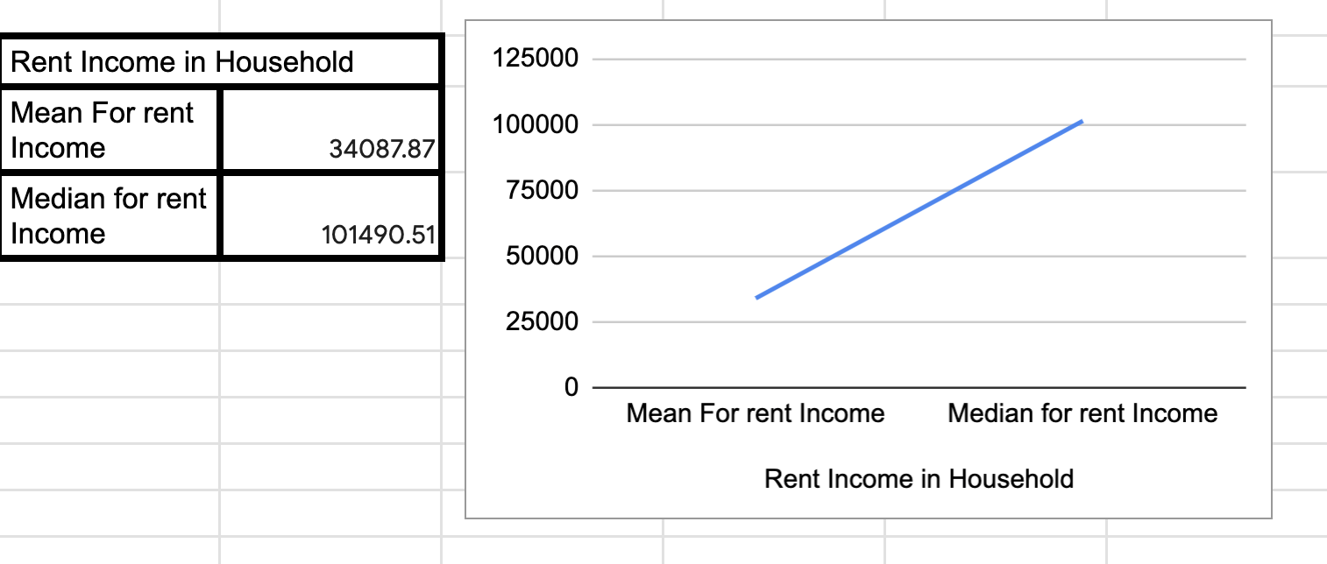
Customer’s Income
I found the average and the median of the income.
There is a higher median then the average.
There is some customers who make more, but there are not many of them.

Slide 7
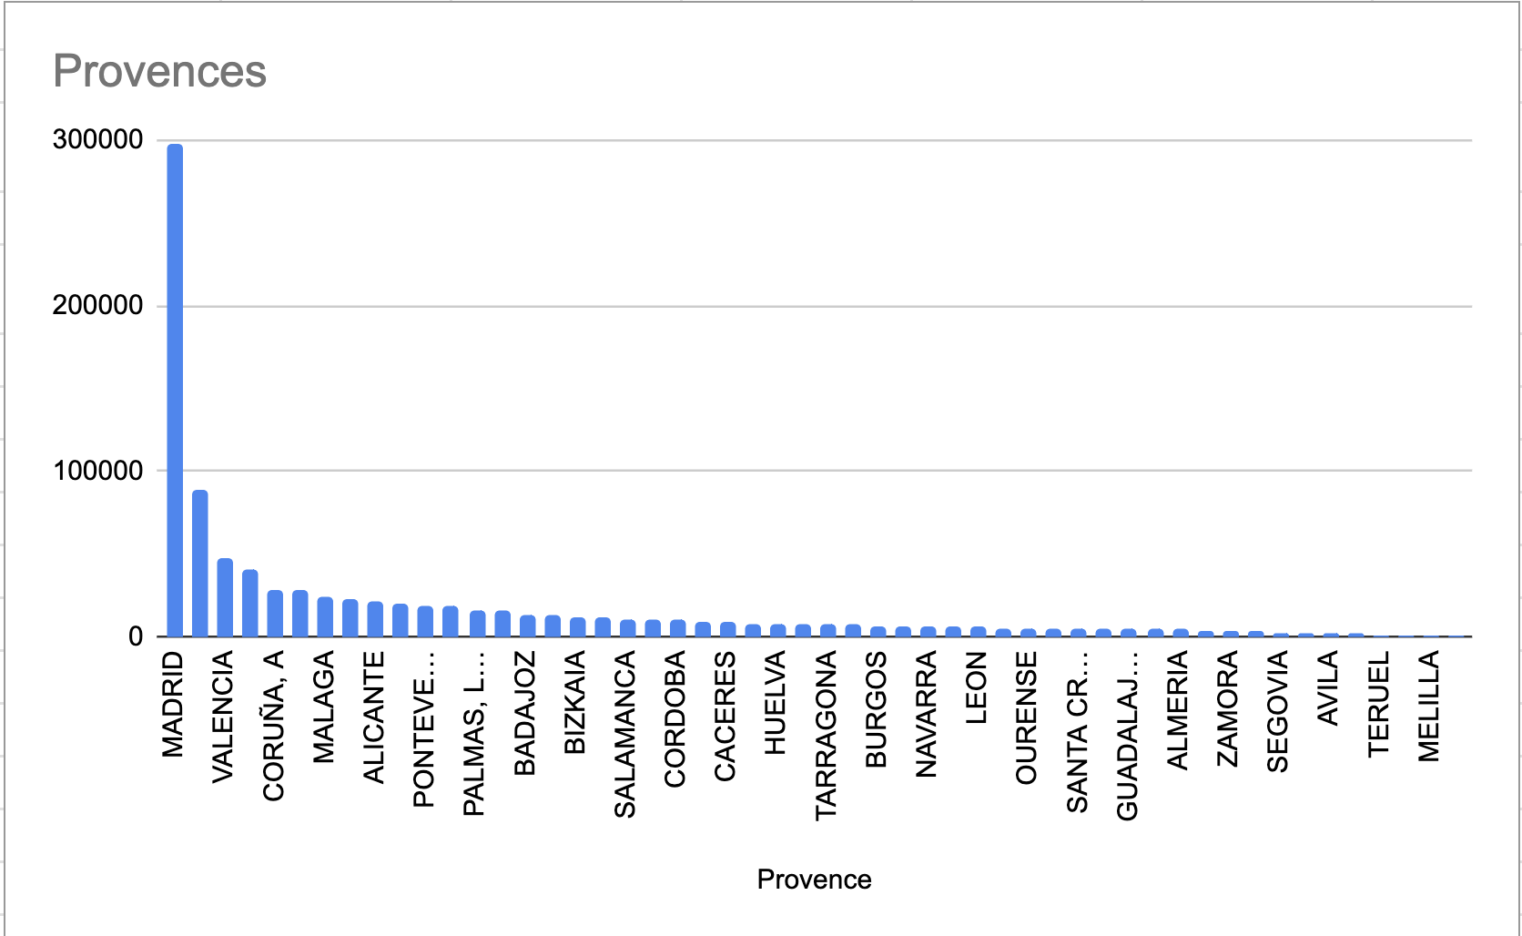
The Province with most customers
I searched up the list of all the provinces and It seems that Madrid has a higher spike.
Madrid and Valencia has a better customer reach for the company.

Slide 8
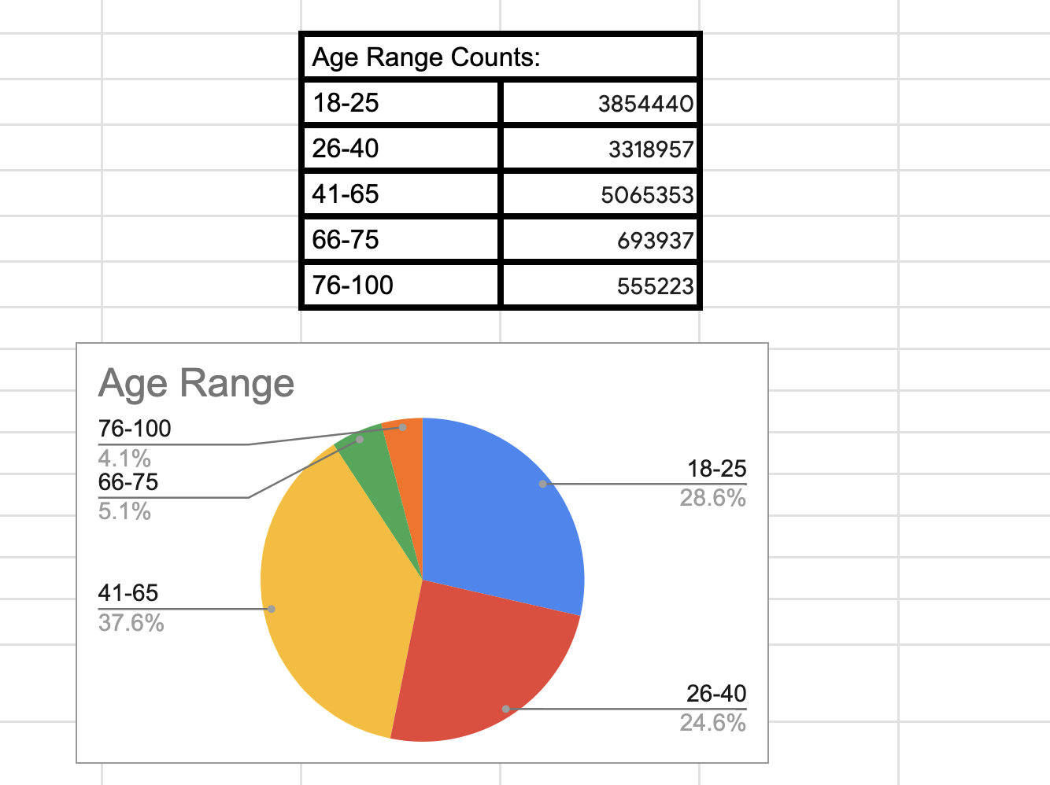
Customer’s age range
There is difference in the age of the customers.
people in their middle age are more open to seek out the company more than younger people and the elderly.
The three major groups that have a spike would be the ranges of 18-25, 26-40, and 42-65

Slide 9
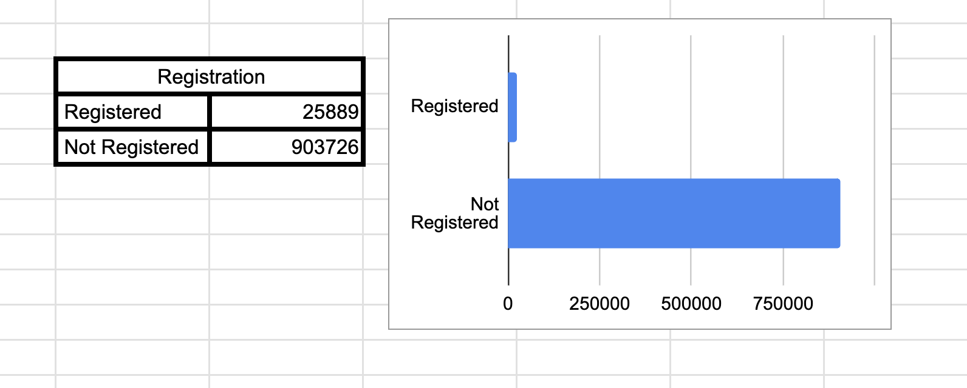
The customer’s who are registered
The following shows that not many customer who are involved with the company are not registered with them
The types of customer that we need to target are the major three age groups.

Slide 10
Cross-Selling or Upselling?
Should we Upsell or Cross-Sell? -I believe we should do Cross Selling because we would want to expand more in different Provinces and make sure the people we do have on board in the company stay loyal based on our good merits that we provide towards them.
-We analyzed every single components of data and we determined the type of customers we have and the people that are registered with the company; moreover, the gender, gross income, and the location where most customers originate from.
-Such factors indicate that for the clients the company has; it is better if they Cross-Sell because it gives a better chance to bring more clientele by giving a good service to the clients. Such action will self promote the company and would greatly expand in other location and target new people each day.

Slide 11
Thank You

